Slide 1

Statistical Ethics - summarized
Tracey Dudding

Slide 2
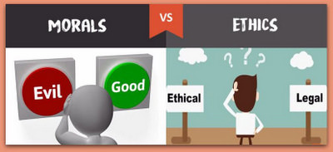
What is ethics?
Ethics, in general, are like morals.
Ethics is the standard of the right or wrong thing.
Morals is the personal viewpoint of the right or wrong thing.
This Photo by Unknown Author is licensed under CC BY-SA-NC
Notes:
NOTES:
Consider clinical trials:
When is it right for a human to be tested on for the results of medical treatment?
Only when there is good reason to believe that the treatment will help the patients who are subjects in the trials.
When is it okay to use a treatment that does no harm to a patient, such as a placebo?
Only when it is to be compared to another treatment and the results of which treatment will do better is unknown.

Slide 3

Basic data ethics - 1
Before beginning, the study must undergo a review by an institutional review board in order to protect the subjects from possible harm.

Slide 4
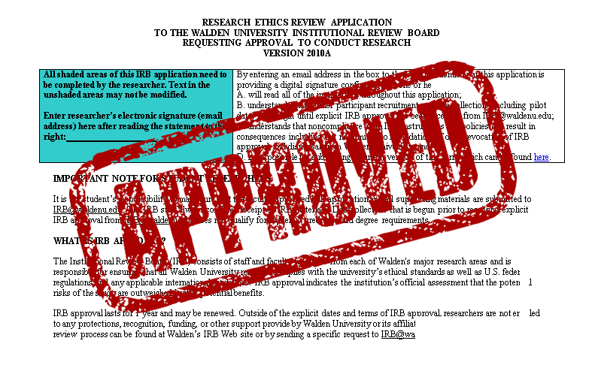
Institutional review boards
Purpose: To protect the rights and welfare of human subjects recruited to participate in research activates by reviewing the plan of study.
This Photo by Unknown Author is licensed under CC BY-NC-ND
Notes:
NOTES:
The review boards job is not done once they approve research. In fact, it is the review boards job to require routine progress, or check ins, on the research.
The review board can disapprove a research proposal with changes for the researchers to resubmit.

Slide 5
Basic data ethics - 2
All individuals who are subjects in a study must give their informed consent before data is collected.

Slide 6
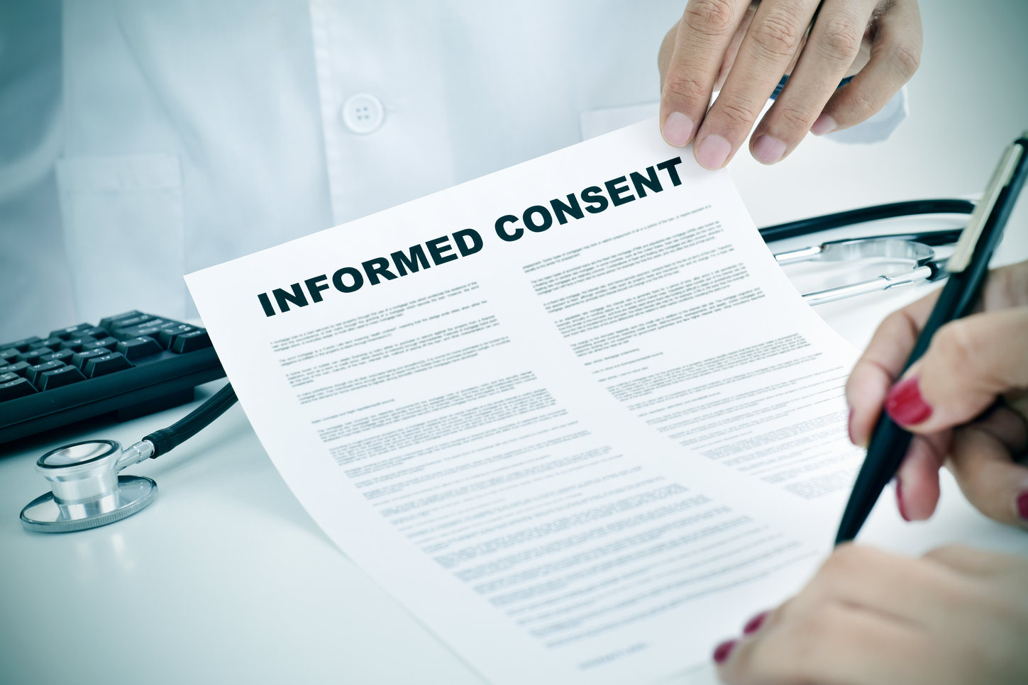
Informed consent
Subjects know about the nature and purpose of a study and any risk of harm.
Once subjects know about the nature, purpose, and risk of a study they may or may not give consent.
This Photo by Unknown Author is licensed under CC BY-ND
Notes:
Notes:
This is for experiments or even surveys.
Informed consent for a survey:
Providing approximately how much time it may take.
Providing what questions may be asked.

Slide 7
Basic data ethics - 3
All individual data must be kept confidential. Only statistical summaries for groups of subjects may be made public.

Slide 8

Confidentiality
vs.
Anonymity
Keeping all data about individuals private or secret.
How to achieve?
Best practice: Separate the identity of the subjects from the remaining data.
Subjects are anonymous
Their names are not known even to the director of the study.
Not commonly seen in statistical studies.
Prevents follow up questions to improve non-responsiveness and prevents informing subjects of results.
This Photo by Unknown Author is licensed under CC BY-ND
Notes:
Go Through Example on Excel File

Slide 9
Let’s see if you have learned proper ethics!
What is wrong with these statements??
Clinical trials, to test medical treatments, are always ethical if they randomly assign patients to the treatments.
The job of an Institutional Review Board is complete when they decide to allow a study to be conducted.
A treatment that has no risk of physical harm to subjects is always ethical.
Notes:
Answers:
1. NO! Clinical trials should use randomized experiments only when there is good reason to believe that the treatment will help the patients who are subjects in the trials.
2. NO! IRB do routinely checks at least once a year.
3. NO! A treatment that has no harm, such as a placebo, should only be given when comparing to another treatment and the results of which will do better is unknown.

Slide 10
Ethics Review
Before any research may begin the research or study’s plan must be reviewed by an Institutional Review Board.
Whenever gathering data, in an experiment or even a survey, informed consent must be obtained by the subjects.
After data is collected, the data must remain confidential.

Slide 11
Resources & Further topics To explore
Ethical Guidelines for Statistical Practice (American Statistical Association)
HIPAA (CDC)
All other content : Exploring the Practices of Statistics (Moor, McCabe, Craig)

